Slide 1
Title I Annual Parent Meeting
Skyview Elementary
August 9, 2021
6:00 pm
Media Center
Suzanne Hester

Slide 2
Celebrate with Title I
Notes:
Celebrate with Title I! Click the video (black box) to view.

Slide 3
About Title I
Title I is the largest federal assistance program for our nation’s schools.
The goal of Title I is to address the academic needs of students and to assist them in meeting their state’s academic standards.
The program serves 75 schools in Pinellas County including eligible students in 34 non-public schools.

Slide 4
Title I Funding
Pinellas County Schools
Increased Student Achievement
Federal Government
1
3
2
4
Florida Department of Education
Skyview Elementary
Notes:
The Florida Department of Education receives funds from the federal government. Districts receive Title I funds from Department of Education, and the school district distributes these funds to schools based on the percentage of children eligible for free/reduced price lunch; however, students do not have to be from low-income families to receive help.

Slide 5
Supplemental
Definition: provided in addition to what is already present or available to complete or enhance it.
https://languages.oup.com/
Notes:
Title I is supplemental federal funding that provides extra academic support and learning opportunities.

Slide 6
Title I Programs Provide Supplemental Support
Supplemental Resource | Positive Impact
Additional supplemental personnel | Hourly teachers, intervention teachers
Additional training opportunities for school staff | Book studies on reading strategies and UDL
Extended Learning Opportunities | After school tutoring (EELP)
Parent and Family Engagement Resources and Training Workshops | Parent Academies
Supplemental teaching materials, equipment, and technology | Diverse literature, non-fiction books and materials
Notes:
Use additional slides if necessary. This is where you want to really highlight Title I funding and how it positively impacts your scholars! Additional supplemental personnel (add specific positions)

Slide 7
Title I Schoolwide Planning
First
Second
Last
Input from school, family, and community members determine how Title I funds are used based on a needs assessment.
Please attend online or in-person meetings/trainings and complete surveys to provide input on Title I funding.
All Title I schools must document that parents are involved in the schoolwide planning process.

Slide 8
Title I Schoolwide Budget
Skyview Elementary is provided $220,800 to pay for supplemental resources and programs for increased student achievement.
Budget Breakdown:
Curriculum Development and Coordination $180,598.68
Capital Outlay $23,000
Supplemental Instructional Materials and Resources $17,201.32

Slide 9
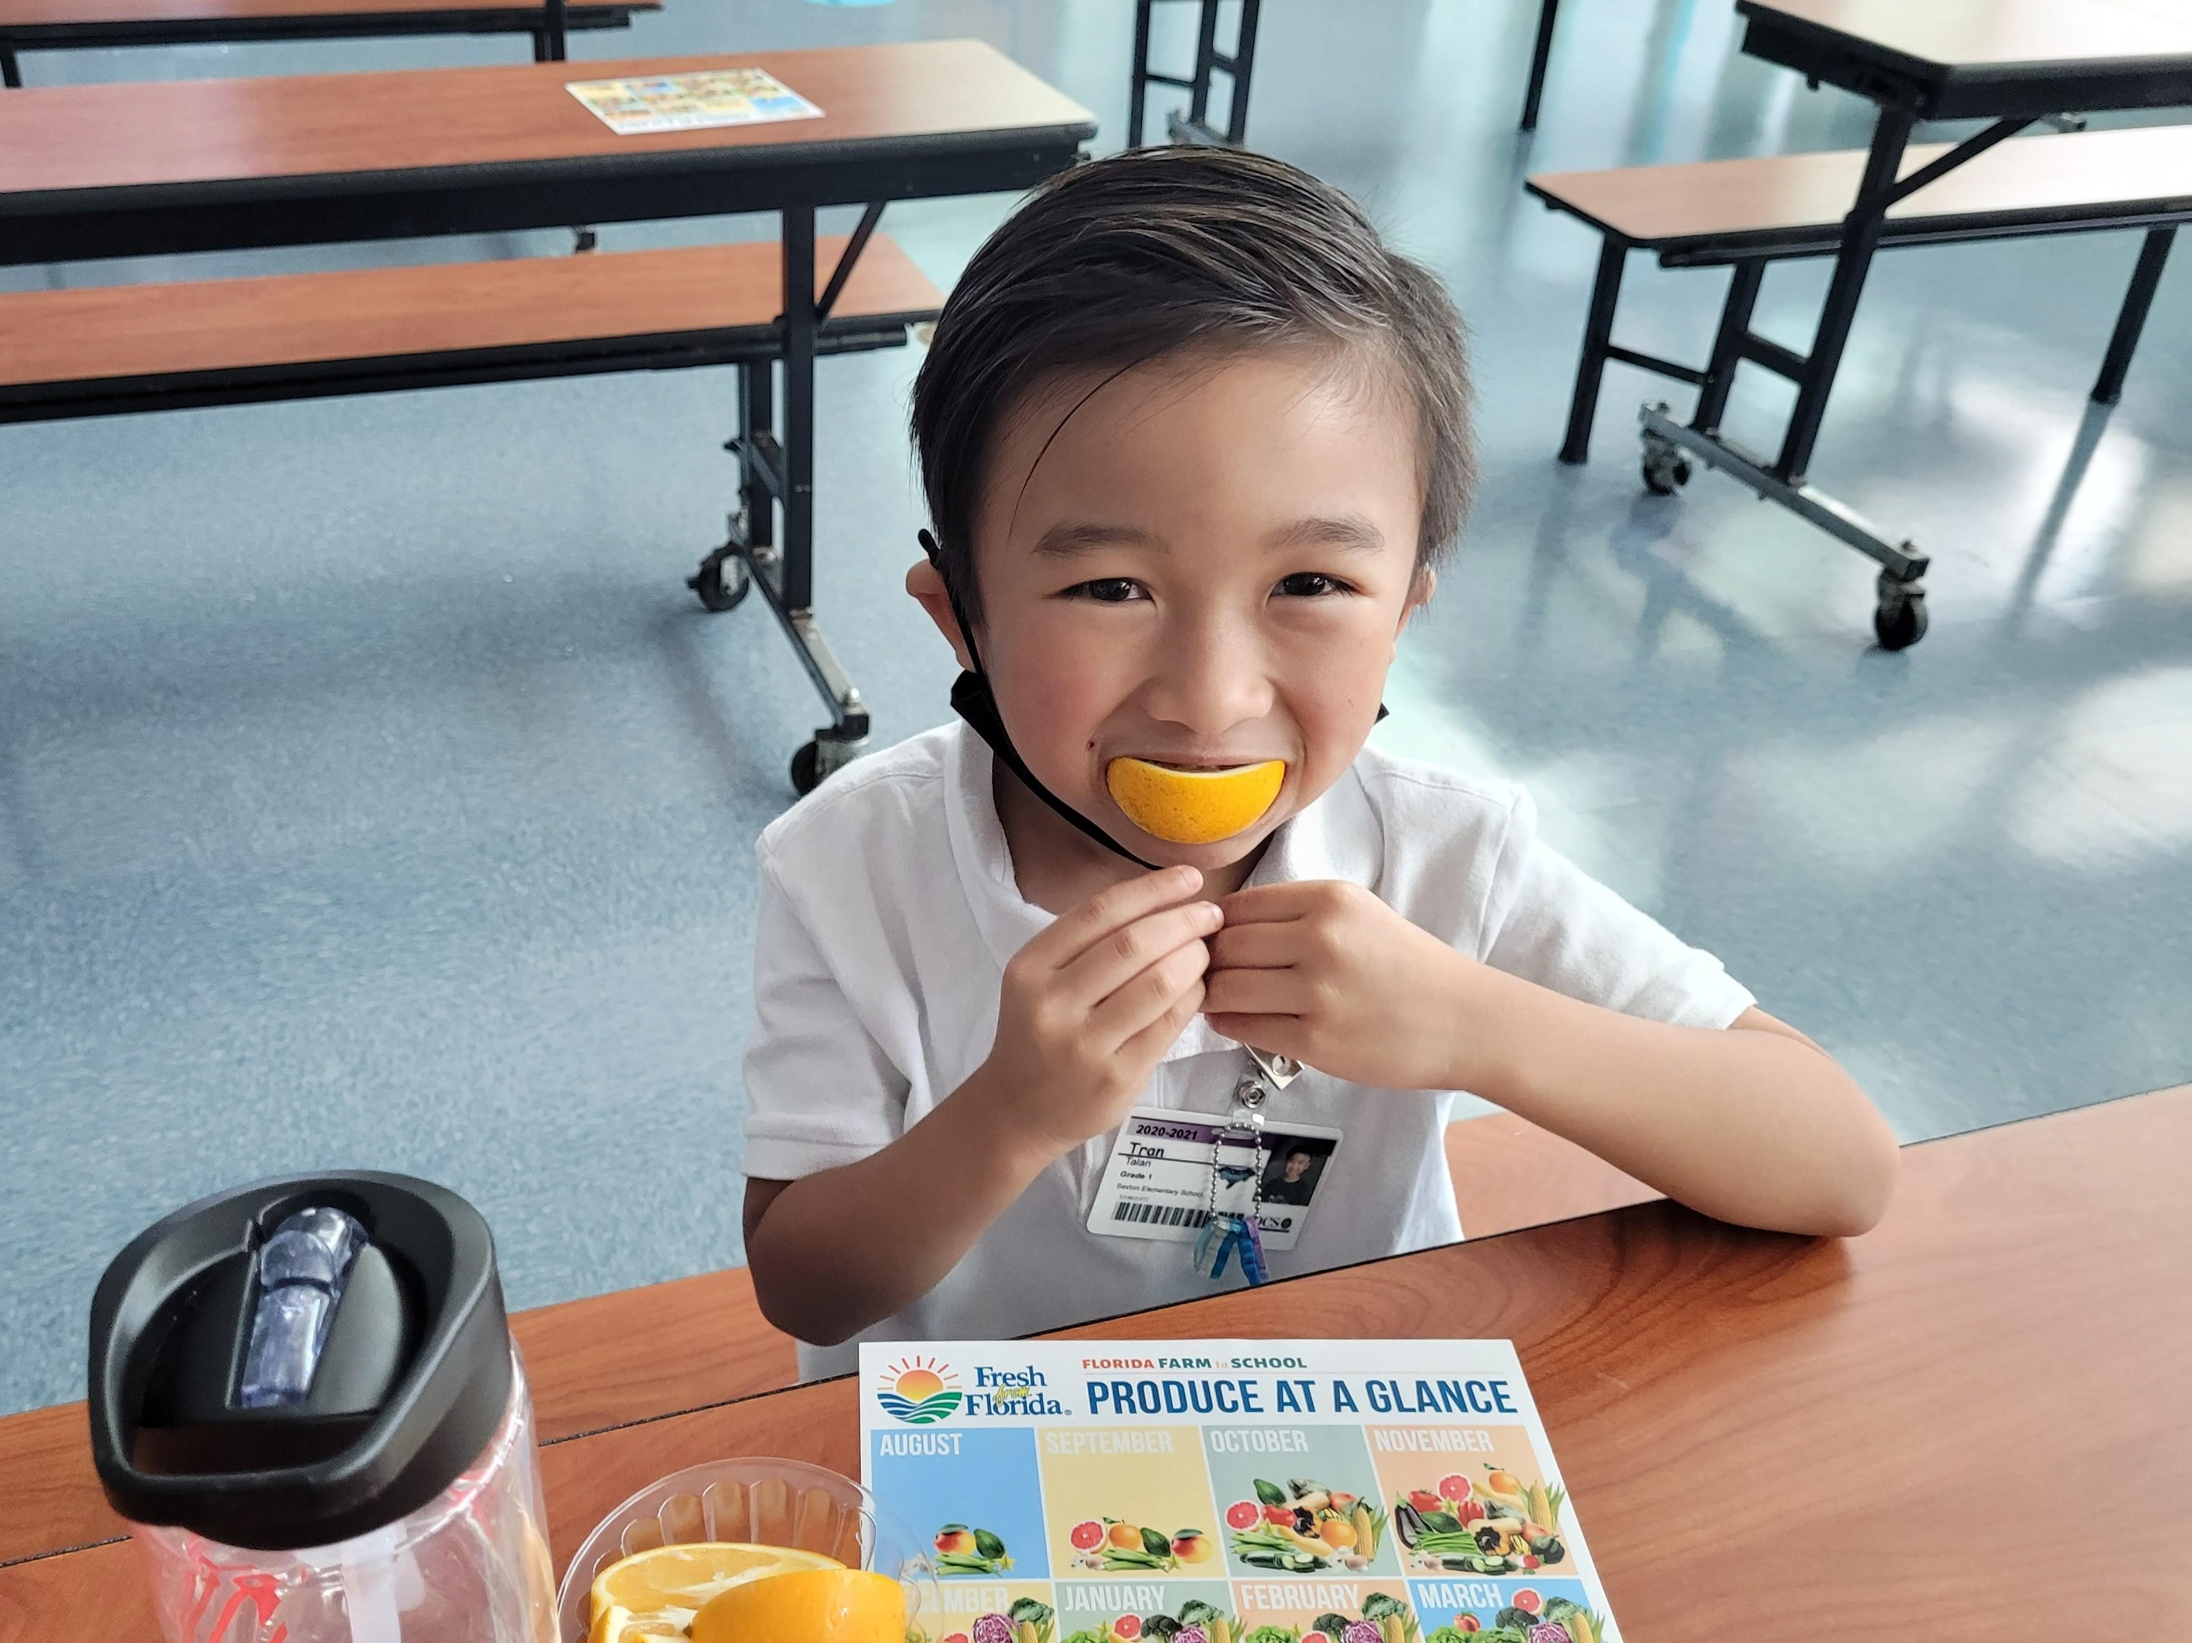
Parent’s Right to Know
As a parent of a student attending a Pinellas County School Public School, you have the right to…
Be provided information on your child’s level of achievement on assessments in Reading/Language Arts, Writing, Mathematics, and Science.
Request and receive information on the qualifications of your child’s teacher and supplemental personnel working with your child.
Be notified of non-highly qualified or out-of-field teachers at the school.
Be informed if your child is taught by a non-highly qualified teacher for four or more consecutive weeks.

Slide 10
Working Together for Student Success
As a Title I parent you have the right to be involved in the development of the following plans and documents for our school which can be found on our website https://www.pcsb.org/skyview-es to view as well as in the Parent Station located in the front office.
School Improvement Plan (SIP)
Title I Schoolwide Plan
Parent and Family Engagement Plan (PFEP)
School-Parent-Student Compact
Notes:
Our school’s Title I Parent Station is located (insert location or photo of Title I Parent Station (front office and on the webpage)
You will find a copy of our School Improvement Plan, Title I Schoolwide Plan, School’s PFEP, the School District’s PFEP, Parent’s Right to Know Memo, Upcoming Events, Compact, (insert other documents at your station)

Slide 11
Parent-School-Student Compact
The purpose of the compact is to foster student achievement. By signing the Parent-School-Student Compact, Skyview Elementary, teachers, staff, parents and students agree to work together to share the responsibility of helping students meet or exceed state, district and school academic goals.
The Parent-School-Student Compact is updated every year to include parent, student, teacher, and staff input. Parent, student, teacher and staff comments are welcome at any time during the year.
Please review and sign your child’s Compact.
Our goal is to receive 100% participation!

Slide 12
Sample School Compact

Slide 13
Parent and Family Engagement Plan (PFEP)
The PFEP Sections include information about the following:
Parent trainings to increase student achievement
Staff trainings for engaging parents
Communication methods between home and school
Flexible meeting times
Accessibility for parents
Coordinating with other Federal Programs
Notes:
Provide information on the specific committees that parents can be involved. Include the purpose, date and time of meetings.
Explain the PFEP and its purpose.

Slide 14
We want YOU!
Parent Advisory Council (PAC)

Slide 15
Parent Advisory Council (PAC)
The District has a Parent and Family Engagement Plan. The summary of this plan is in the Title I School & Family Partnership Overview.
You may access the full plan at www.pcsb.org/titleone
The Parent Advisory Council (PAC) is responsible for reviewing and revising the District PFEP.
PAC will meet virtually or in-person with the district’s Title I Family Education Coordinator.
PAC meets twice a year, if you are interested in representing our school please notify, Suzanne Hester.
Notes:
Please add your PAC representative in slide and email Amy Brown the contact at brownamyl@pcsb.org

Slide 16
Accountability
School Report Cards
School Grade and Overview
Population and Enrollment
Assessments – Academic Achievement, Growth, and Population
Assessments – English Language Learners
Graduation and Beyond
Educator Qualifications and Equity
Long-Term Goals and Interim Progress
Accelerated Course Enrollment
Per-Pupil Expenditures
National Data
Available online at https://edudata.fldoe.org/ or Front Office

Slide 17
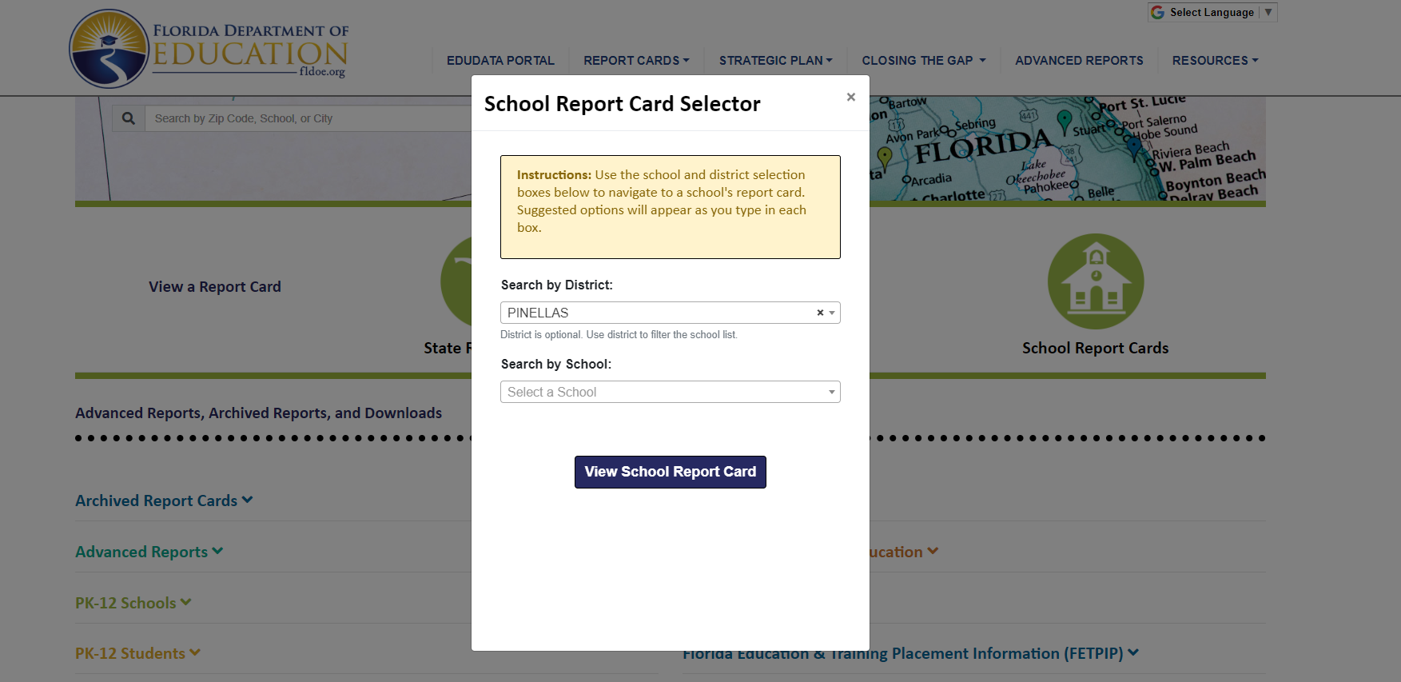
Visit to find district and school grades, EduData Portal
Notes:
When you follow the link EduDataPortal select Pinellas County and search by school.

Slide 18
Florida Standards
Florida’s academic content standards establish high expectations for all students.
Florida Standards identify what your child needs to know and be able to do in all content areas. You may read more information by visiting fldoe.org/academic/standards/.
Also, your child’s teacher will be able to explain the standards for your child’s grade level.
Notes:
All curriculum, instruction and assessments are based on student-centered expectations.

Slide 19
Florida Standards Assessment (FSA)
Fall Assessment-
FLKRS (Florida Kindergarten Readiness Assessment)
Spring Assessments-
ELA Gr 3-10
Math Gr 3-8
Science Grs 5 and 8

Slide 20
Florida End of Course (EOC) Assessments (Algebra 1, Biology, Civics, U.S. History, Geometry)
To learn more about state assessments visit the Florida Department of Education’s website, fldoe.org/accountability/assessments.

Slide 21
Florida Benchmark For Excellent Student Thinking Standards (B.E.S.T). You may read more information by visiting, http://www.fldoe.org/standardsreview/
Notes:
All curriculum, instruction and assessments are based on student-centered expectations.

Slide 22
Notes:
Here is the timeline for the implementation for Florida’s BEST Standards.

Slide 23
Working Together for Student Success
Please join us…
Parent Academies
December 9th - 4th and 5th grades
February 24th - 2nd and 3rd grades
March 10th – Kindergarten and 1st grade

Slide 24
Next Steps
We encourage you to…
Review the Compact throughout the year as it relates to your child(ren)’s goals
Communicate with the teachers and other staff
regularly
Participate in giving your input for our SIP, PFEP, and Compact

Slide 25
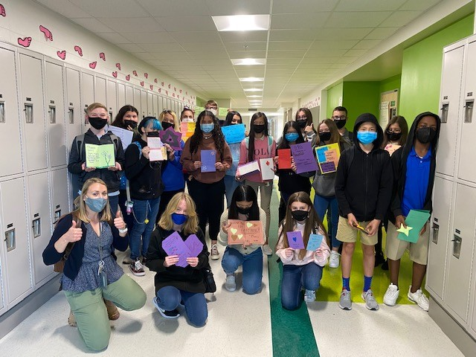
Additional Resources
Title I Parent & Family Coordinator – Amy Brown
brownamyl@pcsb.org
Learning at Home Family Resources - https://www.pcsb.org/Page/32836
Volunteer in a Pinellas County School - https://www.pcsb.org/Page/459
Parent Advocacy – Keosha Simmons simmonskeo@pcsb.org
Parent Academy POWER HOURS Webinars - https://www.pcsb.org/Page/26534
Partnerships - https://www.pcsb.org/Page/418

Slide 26
We appreciate your time!
Please feel free to ask any questions and provide feedback on our Title I Program.

Slide 27
Contact Us
Eagles soar!
8601 60th Street N
Pinellas Park, FL, 33781
(727) 547-7857
https://www.pcsb.org/skyview-es

Slide 28
Education is for improving the lives of others and for leaving your community and world better than you found it.
Marian Wright Edelman

Slide 29
Please take the time to participate in our exit slip survey.
Thank you!
Your feedback is greatly appreciated!
Notes:
Please duplicate Microsoft Forms provided or create school survey. To generate a QR code hover over your school’s survey and and right click. Create QR code for this page will be an option.

